Slide 1
Image Processing
Slides Acknowledgements
Kirsten Grauman, University of Texas at Austin
Other Vision Researchers
Ebook: R. Szeliski

Slide 2
Pixel Transforms
General image processing operations
Function that takes one or more input images and produces an output image.
In the continuous domain,
g(x) = h(f(x)) or g(x) = h(f0 (x),...,fn (x))
For 2D images:
Domain consists of a finite number of pixel locations, x = (i, j), and we can write
g(i,j) = h(f(i,j)).

Slide 3
Pixel Transforms
Commonly used point processes are multiplication and addition with a constant:
g(x) = af (x) + b
Parameters a > 0 and b - called the gain and bias parameters.
Control contrast and brightness.
Bias and gain parameters can also be spatially varying, g(x) = a(x)f (x) + b(x)
Multiplicative gain (both global and spatially varying) is a linear operation:
obeys the superposition principle
h(f0 + f1) = h(f0) + h(f1)

Slide 4
Pixel Transforms
Dyadic (two-input) operator is the linear blend operator
g(x) = (1 − α)f0(x) + αf1(x)
By varying α from 0 → 1, this operator can be used to perform a temporal cross-dissolve between two images or videos.

Slide 5
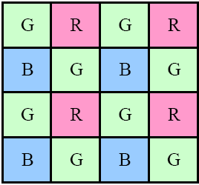
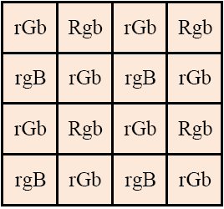
Color Filter Arrays
Separate sensors for three primary colors
Bayer RGB pattern: (a) color filter array layout; (b) interpolated pixel values
Notes:
The luminance signal is mostly determined by green values and the visual system is much more sensitive to high frequency detail in luminance than in chrominance

Slide 6
Color Balance
Move the white point of a given image closer to pure white (R=G=B)
Multiply RGB values by a different factor
Color twist, general 3x3 transform matrix
Notes:
If the illuminant is strongly colored, such as incandescent indoor lighting (which is generally results in a yellow or orange hue), the compensation can be quite significant.

Slide 7
Color Transforms
Adding the same value to each color channel not only increases the apparent intensity of each pixel.
Affects the pixel’s hue and saturation.
Compute and manipulate luminance, Y, and then re-compute RGB
Color balancing (e.g., to compensate for incandescent lighting) can be performed either by multiplying each channel with a different scale factor
Mapping to XYZ color space, changing the nominal white point, and mapping back to RGB, which can be written down using a linear 3 × 3 color twist transform matrix.

Slide 8
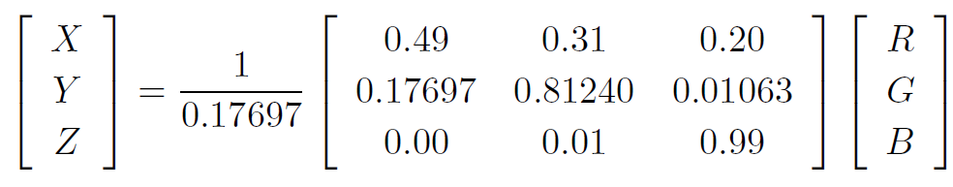
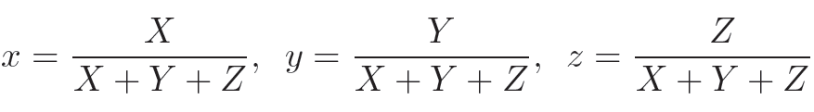
XYZ Color Space
Chromaticity coordinates

Slide 9
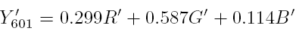
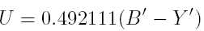
YUV Color Space
YUV for video transmission
Luma
Two lower frequency chroma channels

Slide 10
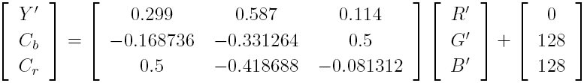
YCrCb Color Space
Closely related to YUV
Different scale factor to fit within the 8-bit range for digital signals
Useful for careful image de-blocking, et al.

Slide 11

HSV Color Space
Hue: direction around a color wheel
Saturation: scaled distance from the diagonal
Value: mean or maximum color value
More suitable for color picking

Slide 12
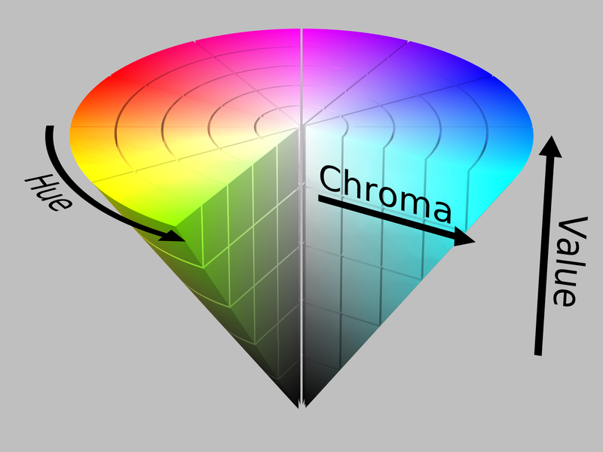
HSV Color Space

Slide 13
Object Manipulation
Process of extracting an object from the original image is often called matting
Process of inserting it into another image (without visible artifacts) is called compositing
In addition to the three color RGB channels, an alpha-matted image contains a fourth alpha channel α (or A).
Describes the relative amount of opacity or fractional coverage at each pixel.
Opacity is the opposite of the transparency. Pixels within the object are fully opaque (α = 1), while pixels fully outside the object are transparent (α = 0).

Slide 14
Object Manipulation
Composite a new (or foreground) image on top of an old (background) image, the overoperator
C =(1−α)B+αF
Attenuates the influence of the background image B by a factor (1 − α) and then adds in the color (and opacity) values corresponding to the foreground layer F

Slide 15
Automating Brightness, Gain,..
One approach might be to look at the darkest and
brightest pixel values in an image and map them to
pure black and pure white.
Another approach might be to find the average value in
the image, push it towards middle gray, and expand the
range so that it more closely fills the displayable values.
How can we visualize the set of lightness values in
an image in order to test some of these heuristics?

Slide 16
Histogram Equalization
In a class of n students, with exam scores {s1,…,sn},
how do you compute percentile?
How do you compute percentile of gray scale histograms?

Slide 17
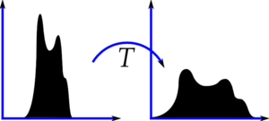
Histogram Equalization

Slide 18
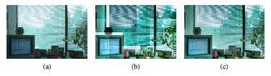
Histogram Equalization
Locally adaptive histogram equalization: (a) original image; (b) block histogram equalization; (c) full locally adaptive equalization.

Slide 19
Possible Approach
Integrate the distribution h(I) to obtain the cumulative distribution c(I),
c(I) = 1/ N ∑ h(i) = c(I − 1) + 1/N * h(I)
where N is the number of pixels in the image or students in the class.
For any given grade or intensity, we can look up its corresponding percentile c(I) and determine the final value that pixel should take.
When working with eight-bit pixel values, the I and c axes are rescaled from [0, 255].

Slide 20
Possible Approach
If the resulting histogram is flat; so is the resulting image
May lack contrast.
One way to compensate for this is to only partially compensate for the histogram unevenness
Use a mapping function f (I ) = αc(I) + (1 − α)I,
Linear blend between the cumulative distribution function and the identity transform (a straight line).
Another potential problem with histogram equalization (or, in general, image brightening) - noise in dark regions can be amplified and become more visible.

Slide 21
Locally Adaptive Histograms
For images wide range of luminance values
Subdivide the image into M × M pixel blocks and
Perform separate histogram equalization in each sub-block
Resulting image can have artifacts
Solution: Moving windows
Recompute the histogram for every M × M block
centered at each pixel.
Can be quite slow (M² operations per pixel),
Trick: update only the histogram entries corresponding to
the pixels entering and leaving the block (in a raster scan
across the image) need to be updated
(M operations per pixel).

Slide 22
Locally Adaptive Histograms
Another solution: compute non-overlapped block-based
equalization functions as before,
Smoothly interpolate the transfer functions across blocks
Known as adaptive histogram equalization (AHE)
The weighting function for a given pixel (i,j) - computed as
a function of its horizontal and vertical position (s, t)
To blend the four lookup functions {f₀₀, . . . , f₁₁}, a
bilinear blending function,
f_{s,t} (I) = (1 − s)(1 − t)f₀₀(I) + s(1 − t)f₁₀(I) + (1 − s)tf₀₁(I) + stf₁₁(I)

Slide 23
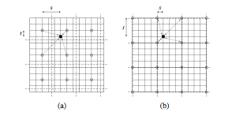
Block-based histograms, with block centers shown as circles;
Corner-based “spline” histograms. Pixels are located on grid intersections.

Slide 24
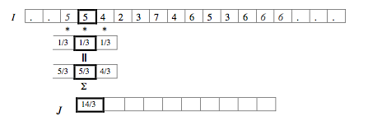
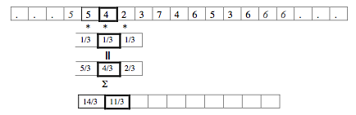
Correlation

Slide 25
Correlation
Suppose F is a correlation filter.
Convenient if F has an odd number of elements
As it shifts, its center is right on top of an element of I.
Let F have 2N+1 elements, indexed from -N to N.
Center element of F is F(0).
F o I(x)= Σ_{i=-N to N} F(i)I(x+i)
where the circle denotes correlation.
With this notation, we can define a simple box filter as:
F(i) = 1/3 for i = −1,0,1
0 for i ≠ −1,0,1

Slide 26
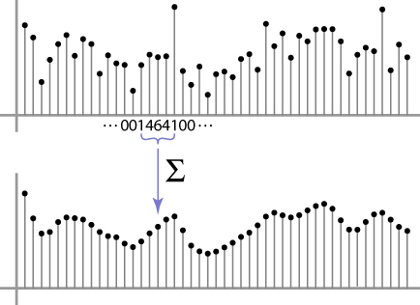
Weighted Moving Average
Non-uniform weights [1, 4, 6, 4, 1] / 16
Source: S. Marschner

Slide 27
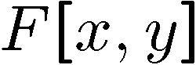
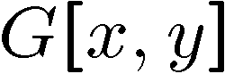
Moving Average In 2D
0 | 0 | 0 | 0 | 0 | 0 | 0 | 0 | 0 | 0
0 | 0 | 0 | 0 | 0 | 0 | 0 | 0 | 0 | 0
0 | 0 | 0 | 90 | 90 | 90 | 90 | 90 | 0 | 0
0 | 0 | 0 | 90 | 90 | 90 | 90 | 90 | 0 | 0
0 | 0 | 0 | 90 | 90 | 90 | 90 | 90 | 0 | 0
0 | 0 | 0 | 90 | 0 | 90 | 90 | 90 | 0 | 0
0 | 0 | 0 | 90 | 90 | 90 | 90 | 90 | 0 | 0
0 | 0 | 0 | 0 | 0 | 0 | 0 | 0 | 0 | 0
0 | 0 | 90 | 0 | 0 | 0 | 0 | 0 | 0 | 0
0 | 0 | 0 | 0 | 0 | 0 | 0 | 0 | 0 | 0
 | 0
0 | 0 | 0 | 0 | 0 | 0 | 0 | 0 | 0 | 0
0 | 0 | 0 | 0 | 0 | 0 | 0 | 0 | 0 | 0
0 | 0 | 0 | 90 | 90 | 90 | 90 | 90 | 0 | 0
0 | 0 | 0 | 90 | 90 | 90 | 90 | 90 | 0 | 0
0 | 0 | 0 | 90 | 90 | 90 | 90 | 90 | 0 | 0
0 | 0 | 0 | 90 | 0 | 90 | 90 | 90 | 0 | 0
0 | 0 | 0 | 90 | 90 | 90 | 90 | 90 | 0 | 0
0 | 0 | 0 | 0 | 0 | 0 | 0 | 0 | 0 | 0
0 | 0 | 90 | 0 | 0 | 0 | 0 | 0 | 0 | 0
0 | 0 | 0 | 0 | 0 | 0 | 0 | 0 | 0 | 0
Source: S. Seitz

Slide 28
Moving Average In 2D
0 | 0 | 0 | 0 | 0 | 0 | 0 | 0 | 0 | 0
0 | 0 | 0 | 0 | 0 | 0 | 0 | 0 | 0 | 0
0 | 0 | 0 | 90 | 90 | 90 | 90 | 90 | 0 | 0
0 | 0 | 0 | 90 | 90 | 90 | 90 | 90 | 0 | 0
0 | 0 | 0 | 90 | 90 | 90 | 90 | 90 | 0 | 0
0 | 0 | 0 | 90 | 0 | 90 | 90 | 90 | 0 | 0
0 | 0 | 0 | 90 | 90 | 90 | 90 | 90 | 0 | 0
0 | 0 | 0 | 0 | 0 | 0 | 0 | 0 | 0 | 0
0 | 0 | 90 | 0 | 0 | 0 | 0 | 0 | 0 | 0
0 | 0 | 0 | 0 | 0 | 0 | 0 | 0 | 0 | 0
 | 0 | 10
0 | 0 | 0 | 0 | 0 | 0 | 0 | 0 | 0 | 0
0 | 0 | 0 | 0 | 0 | 0 | 0 | 0 | 0 | 0
0 | 0 | 0 | 90 | 90 | 90 | 90 | 90 | 0 | 0
0 | 0 | 0 | 90 | 90 | 90 | 90 | 90 | 0 | 0
0 | 0 | 0 | 90 | 90 | 90 | 90 | 90 | 0 | 0
0 | 0 | 0 | 90 | 0 | 90 | 90 | 90 | 0 | 0
0 | 0 | 0 | 90 | 90 | 90 | 90 | 90 | 0 | 0
0 | 0 | 0 | 0 | 0 | 0 | 0 | 0 | 0 | 0
0 | 0 | 90 | 0 | 0 | 0 | 0 | 0 | 0 | 0
0 | 0 | 0 | 0 | 0 | 0 | 0 | 0 | 0 | 0
Source: S. Seitz

Slide 29
Moving Average In 2D
0 | 0 | 0 | 0 | 0 | 0 | 0 | 0 | 0 | 0
0 | 0 | 0 | 0 | 0 | 0 | 0 | 0 | 0 | 0
0 | 0 | 0 | 90 | 90 | 90 | 90 | 90 | 0 | 0
0 | 0 | 0 | 90 | 90 | 90 | 90 | 90 | 0 | 0
0 | 0 | 0 | 90 | 90 | 90 | 90 | 90 | 0 | 0
0 | 0 | 0 | 90 | 0 | 90 | 90 | 90 | 0 | 0
0 | 0 | 0 | 90 | 90 | 90 | 90 | 90 | 0 | 0
0 | 0 | 0 | 0 | 0 | 0 | 0 | 0 | 0 | 0
0 | 0 | 90 | 0 | 0 | 0 | 0 | 0 | 0 | 0
0 | 0 | 0 | 0 | 0 | 0 | 0 | 0 | 0 | 0
 | 0 | 10 | 20
0 | 0 | 0 | 0 | 0 | 0 | 0 | 0 | 0 | 0
0 | 0 | 0 | 0 | 0 | 0 | 0 | 0 | 0 | 0
0 | 0 | 0 | 90 | 90 | 90 | 90 | 90 | 0 | 0
0 | 0 | 0 | 90 | 90 | 90 | 90 | 90 | 0 | 0
0 | 0 | 0 | 90 | 90 | 90 | 90 | 90 | 0 | 0
0 | 0 | 0 | 90 | 0 | 90 | 90 | 90 | 0 | 0
0 | 0 | 0 | 90 | 90 | 90 | 90 | 90 | 0 | 0
0 | 0 | 0 | 0 | 0 | 0 | 0 | 0 | 0 | 0
0 | 0 | 90 | 0 | 0 | 0 | 0 | 0 | 0 | 0
0 | 0 | 0 | 0 | 0 | 0 | 0 | 0 | 0 | 0
Source: S. Seitz

Slide 30
Moving Average In 2D
0 | 0 | 0 | 0 | 0 | 0 | 0 | 0 | 0 | 0
0 | 0 | 0 | 0 | 0 | 0 | 0 | 0 | 0 | 0
0 | 0 | 0 | 90 | 90 | 90 | 90 | 90 | 0 | 0
0 | 0 | 0 | 90 | 90 | 90 | 90 | 90 | 0 | 0
0 | 0 | 0 | 90 | 90 | 90 | 90 | 90 | 0 | 0
0 | 0 | 0 | 90 | 0 | 90 | 90 | 90 | 0 | 0
0 | 0 | 0 | 90 | 90 | 90 | 90 | 90 | 0 | 0
0 | 0 | 0 | 0 | 0 | 0 | 0 | 0 | 0 | 0
0 | 0 | 90 | 0 | 0 | 0 | 0 | 0 | 0 | 0
0 | 0 | 0 | 0 | 0 | 0 | 0 | 0 | 0 | 0
 | 0 | 10 | 20 | 30 | 30
Source: S. Seitz

Slide 31
Moving Average In 2D
0 | 0 | 0 | 0 | 0 | 0 | 0 | 0 | 0 | 0
0 | 0 | 0 | 0 | 0 | 0 | 0 | 0 | 0 | 0
0 | 0 | 0 | 90 | 90 | 90 | 90 | 90 | 0 | 0
0 | 0 | 0 | 90 | 90 | 90 | 90 | 90 | 0 | 0
0 | 0 | 0 | 90 | 90 | 90 | 90 | 90 | 0 | 0
0 | 0 | 0 | 90 | 0 | 90 | 90 | 90 | 0 | 0
0 | 0 | 0 | 90 | 90 | 90 | 90 | 90 | 0 | 0
0 | 0 | 0 | 0 | 0 | 0 | 0 | 0 | 0 | 0
0 | 0 | 90 | 0 | 0 | 0 | 0 | 0 | 0 | 0
0 | 0 | 0 | 0 | 0 | 0 | 0 | 0 | 0 | 0
 | 0 | 10 | 20 | 30 | 30 | 30 | 20 | 10
 | 0 | 20 | 40 | 60 | 60 | 60 | 40 | 20
 | 0 | 30 | 60 | 90 | 90 | 90 | 60 | 30
 | 0 | 30 | 50 | 80 | 80 | 90 | 60 | 30
 | 0 | 30 | 50 | 80 | 80 | 90 | 60 | 30
 | 0 | 20 | 30 | 50 | 50 | 60 | 40 | 20
 | 10 | 20 | 30 | 30 | 30 | 30 | 20 | 10
 | 10 | 10 | 10 | 0 | 0 | 0 | 0 | 0
Source: S. Seitz
Notes:
ones, divide by 9

Slide 32
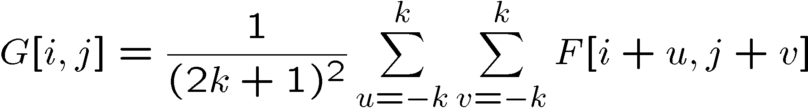
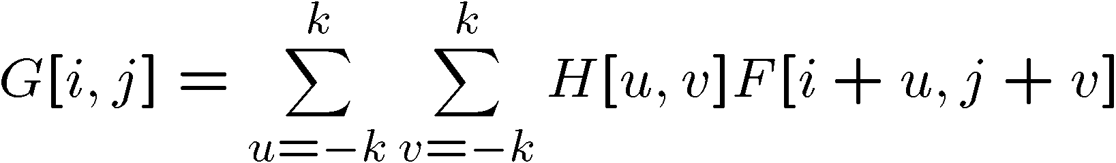
Correlation filtering
Say the averaging window size is 2k+1 x 2k+1:
Attribute uniform weight to each pixel
Loop over all pixels in neighborhood around image pixel F[i,j]
Now generalize to allow different weights depending on neighboring pixel’s relative position:
Non-uniform weights

Slide 33
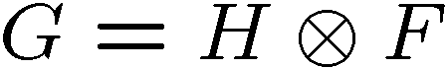
Correlation filtering
This is called cross-correlation, denoted
Filtering an image: replace each pixel with a linear combination of its neighbors.
The filter “kernel” or “mask” H[u,v] is the prescription for the weights in the linear combination.

Slide 34

Moving average
Let’s replace each pixel with a weighted average of its neighborhood
The weights are called the filter kernel
What are the weights for the average of a 3x3 neighborhood?
1
1
1
1
1
1
1
1
1
“box filter”
Source: D. Lowe

Slide 35
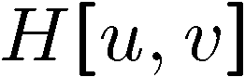
Averaging filter
0 | 0 | 0 | 0 | 0 | 0 | 0 | 0 | 0 | 0
0 | 0 | 0 | 0 | 0 | 0 | 0 | 0 | 0 | 0
0 | 0 | 0 | 90 | 90 | 90 | 90 | 90 | 0 | 0
0 | 0 | 0 | 90 | 90 | 90 | 90 | 90 | 0 | 0
0 | 0 | 0 | 90 | 90 | 90 | 90 | 90 | 0 | 0
0 | 0 | 0 | 90 | 0 | 90 | 90 | 90 | 0 | 0
0 | 0 | 0 | 90 | 90 | 90 | 90 | 90 | 0 | 0
0 | 0 | 0 | 0 | 0 | 0 | 0 | 0 | 0 | 0
0 | 0 | 90 | 0 | 0 | 0 | 0 | 0 | 0 | 0
0 | 0 | 0 | 0 | 0 | 0 | 0 | 0 | 0 | 0
 | 0 | 10 | 20 | 30 | 30
1
1
1
1
1
1
1
1
1
“box filter”

Slide 36
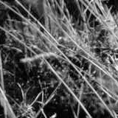
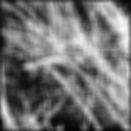
Smoothing by averaging
depicts box filter:
white = high value, black = low value
original
filtered
What if the filter size was 5 x 5 instead of 3 x 3?

Slide 37
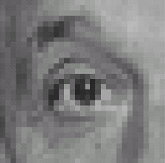
Practice with linear filters
0
0
0
?
0
1
0
0
0
0
Original
Source: D. Lowe

Slide 38
Practice with linear filters
0
0
0
0
1
0
0
0
0
Original
Filtered
(no change)
Source: D. Lowe

Slide 39
Practice with linear filters
0
0
0
?
0
0
1
0
0
0
Original
Source: D. Lowe

Slide 40
Practice with linear filters
0
0
0
0
0
1
0
0
0
Original
Shifted left
By 1 pixel
Source: D. Lowe

Slide 41
Practice with linear filters
1
1
1
?
1
1
1
1
1
1
Original
Source: D. Lowe

Slide 42
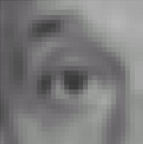
Practice with linear filters
1
1
1
1
1
1
1
1
1
Original
Blur (with a
box filter)
Source: D. Lowe

Slide 43
Practice with linear filters
0
0
0
-
1
1
1
?
0
2
0
1
1
1
0
0
0
1
1
1
(Note that filter sums to 1)
Original
Source: D. Lowe

Slide 44
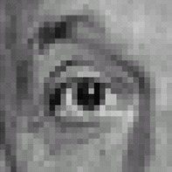
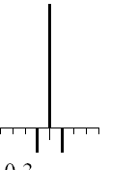
Practice with linear filters
0
0
0
-
1
1
1
0
2
0
1
1
1
0
0
0
1
1
1
Original
Sharpening filter
Accentuates differences with local average
Source: D. Lowe

Slide 45
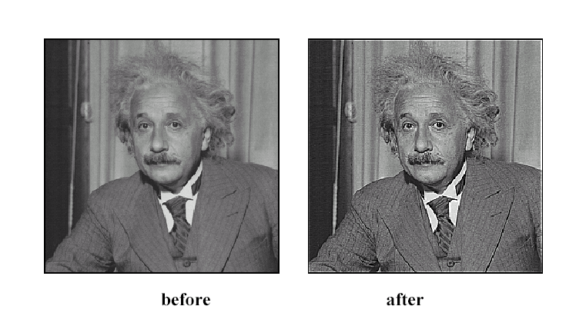
Sharpening
Source: D. Lowe

Slide 46
Smoothing with box filter
Smoothing with an average actually doesn’t compare at all well with a defocused lens
Most obvious difference is that a single point of light viewed in a defocused lens looks like a fuzzy blob; but the averaging process would give a little square
Better idea: to eliminate edge effects, weight contribution of neighborhood pixels according to their closeness to the center, like so:
“fuzzy blob”
Notes:
I always walk through the argument on the left rather carefully; it gives some insight into the
significance of impulse responses or point spread functions.

Slide 47
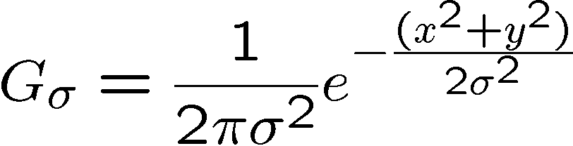
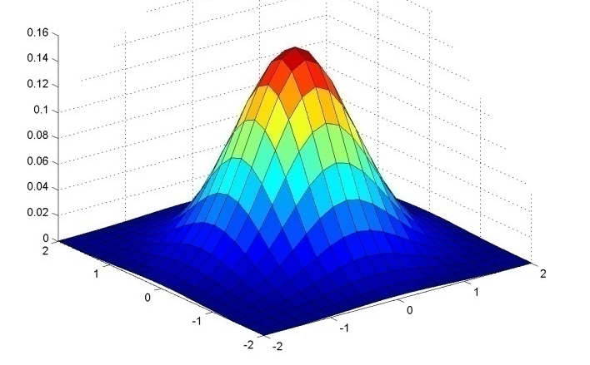
Gaussian Kernel
0.003 0.013 0.022 0.013 0.003
0.013 0.059 0.097 0.059 0.013
0.022 0.097 0.159 0.097 0.022
0.013 0.059 0.097 0.059 0.013
0.003 0.013 0.022 0.013 0.003
5 x 5, σ = 1
Constant factor at front makes volume sum to 1 (can be ignored, as we should re-normalize weights to sum to 1 in any case)
Source: C. Rasmussen

Slide 48
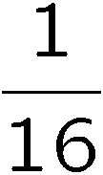
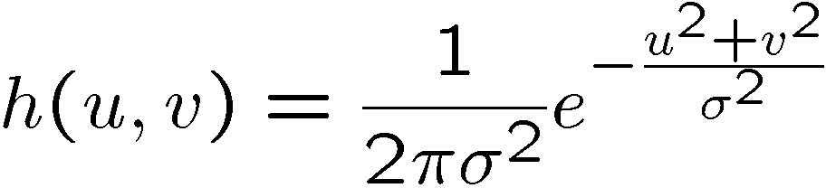
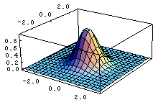
Gaussian filter
What if we want nearest neighboring pixels to have the most influence on the output?
Removes high-frequency components from the image (“low-pass filter”).
0 | 0 | 0 | 0 | 0 | 0 | 0 | 0 | 0 | 0
0 | 0 | 0 | 0 | 0 | 0 | 0 | 0 | 0 | 0
0 | 0 | 0 | 90 | 90 | 90 | 90 | 90 | 0 | 0
0 | 0 | 0 | 90 | 90 | 90 | 90 | 90 | 0 | 0
0 | 0 | 0 | 90 | 90 | 90 | 90 | 90 | 0 | 0
0 | 0 | 0 | 90 | 0 | 90 | 90 | 90 | 0 | 0
0 | 0 | 0 | 90 | 90 | 90 | 90 | 90 | 0 | 0
0 | 0 | 0 | 0 | 0 | 0 | 0 | 0 | 0 | 0
0 | 0 | 90 | 0 | 0 | 0 | 0 | 0 | 0 | 0
0 | 0 | 0 | 0 | 0 | 0 | 0 | 0 | 0 | 0
This kernel is an approximation of a 2d Gaussian function:
1 | 2 | 1
2 | 4 | 2
1 | 2 | 1
Source: S. Seitz

Slide 49
Choosing kernel width
Gaussian filters have infinite support, but discrete filters use finite kernels
Source: K. Grauman

Slide 50
Choosing kernel width
Rule of thumb: set filter half-width to about 3 σ

Slide 51

Example: Smoothing with a Gaussian

Slide 52
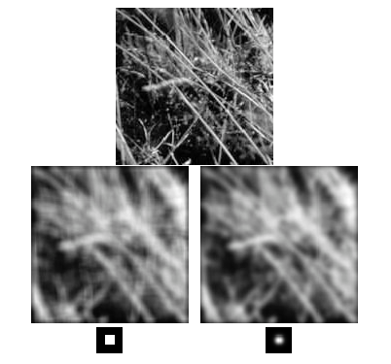
Mean vs. Gaussian filtering

Slide 53
Gaussian filters
Remove “high-frequency” components from the image (low-pass filter)
Convolution with self is another Gaussian
So can smooth with small-width kernel, repeat, and get same result as larger-width kernel would have
Convolving two times with Gaussian kernel of width σ is same as convolving once with kernel of width σ√2
Separable kernel
Factors into product of two 1D Gaussians
Source: K. Grauman
Notes:
Linear vs. quadratic in mask size

Slide 54
Smoothing filters - properties
Smoothing
Values positive
Sum to 1 → constant regions same as input
Amount of smoothing proportional to mask size
Remove “high-frequency” components; “low-pass” filter

Slide 55
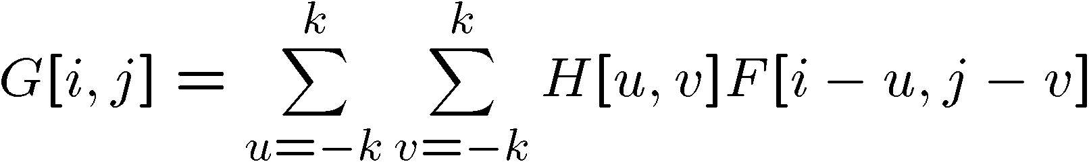
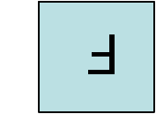

Convolution
Convolution:
Flip the filter in both dimensions (bottom to top, right to left)
Then apply cross-correlation
F
H
Notation for convolution operator

Slide 56
Convolution vs. correlation
Convolution
Cross-correlation
For a Gaussian or box filter, how will the outputs differ?
If the input is an impulse signal, how will the outputs differ?

Slide 57
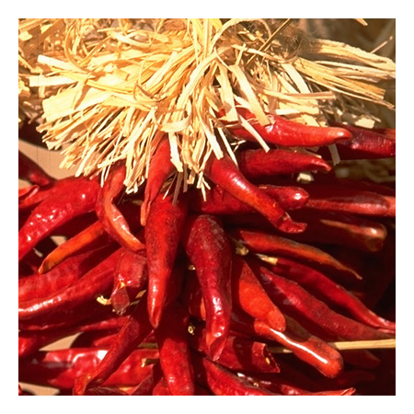
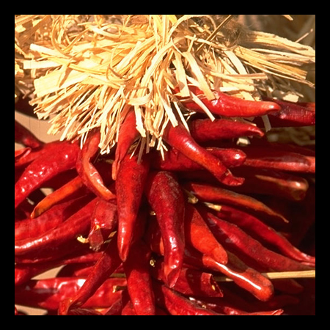

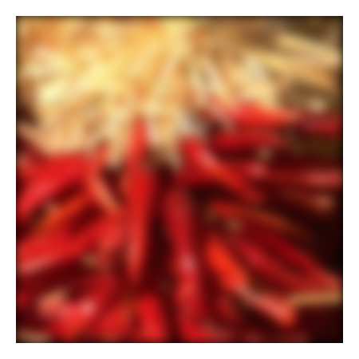


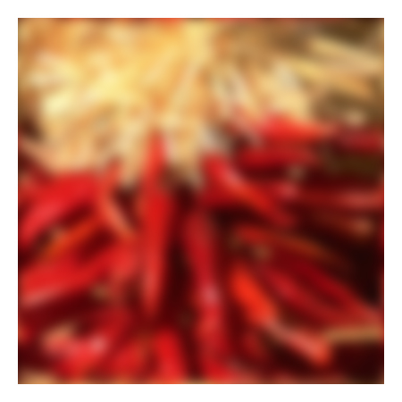



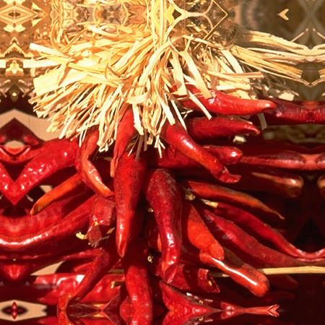


Boundary issues
What about near the edge?
the filter window falls off the edge of the image
need to extrapolate
methods:
clip filter (black)
wrap around
copy edge
reflect across edge
Source: S. Marschner

Slide 58
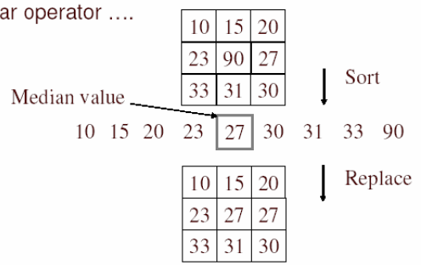
Alternative: Median filtering
A median filter operates over a window by selecting the median intensity in the window
Is median filtering linear?
Source: K. Grauman
Notes:
Linearity of median filter: try filter([0 0 0; 0 1 0; 0 0 0] + [1 1 1; 1 1 2; 2 2 2])

Slide 59
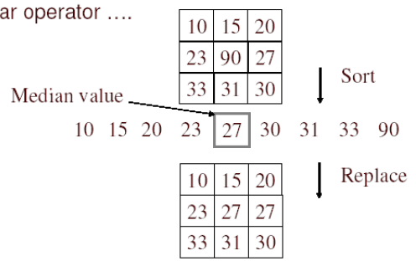
Median filter
No new pixel values introduced
Removes spikes: good for impulse, salt & pepper noise
Non-linear filter

Slide 60
Median filter
Replace each pixel by the median over N pixels (5 pixels, for these examples). Generalizes to “rank order” filters.
Median([1 7 1 5 1]) = 1
Mean([1 7 1 5 1]) = 2.8
In:
Out:
Spike noise is removed
5-pixel neighborhood
Monotonic edges remain unchanged
In:
Out:

Slide 61
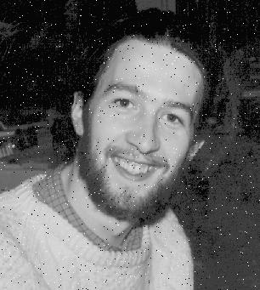

Median filtering results
Best for salt and pepper noise
http://homepages.inf.ed.ac.uk/rbf/HIPR2/mean.htm#guidelines

Slide 62
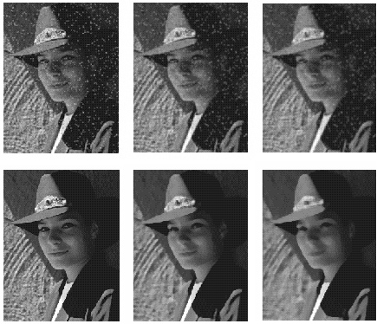
Median vs. Gaussian filtering
3x3
5x5
7x7
Gaussian
Median

Slide 63
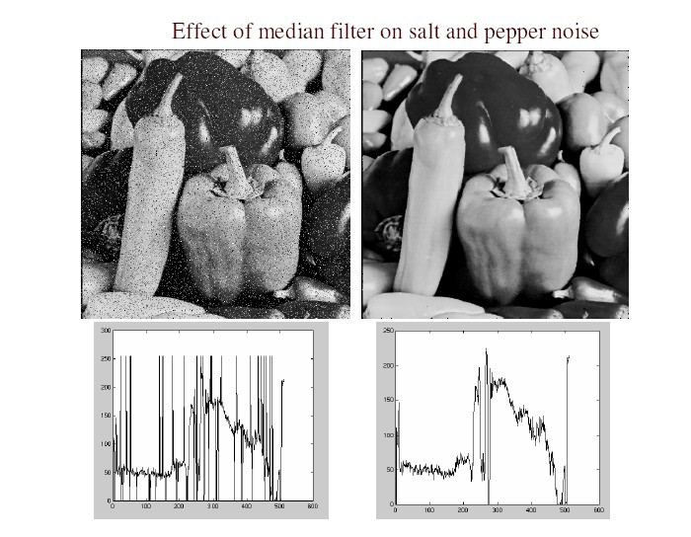
Median filter
Salt and pepper noise
Median filtered
Plots of a row of the image
Source: M. Hebert

Slide 64
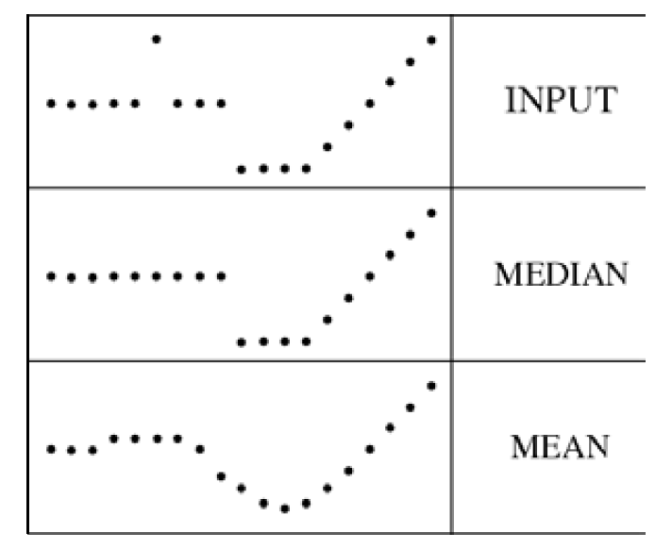
Median filter
Median filter is edge preserving

Slide 65
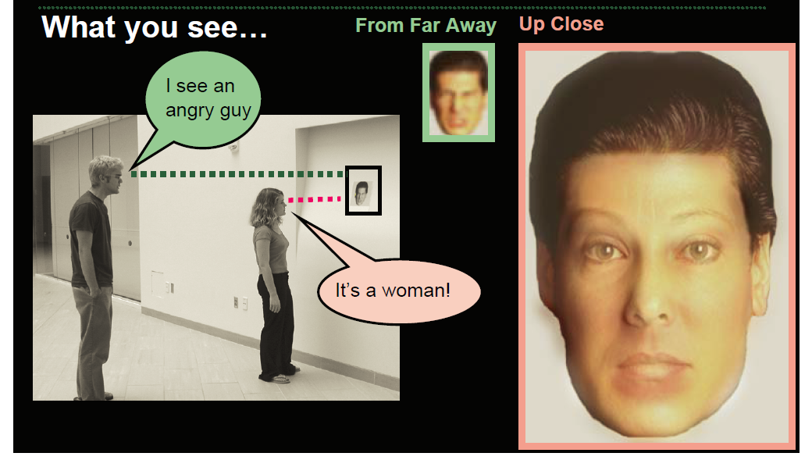
Filtering: Hybrid Images
Aude Oliva & Antonio Torralba & Philippe G Schyns, SIGGRAPH 2006
Notes:
\

Slide 66
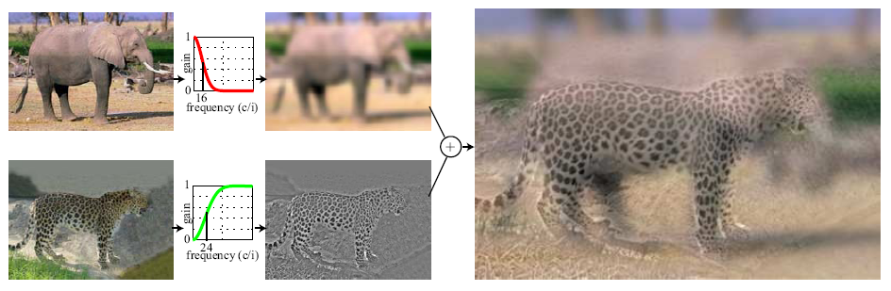
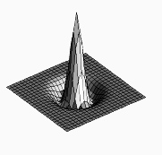

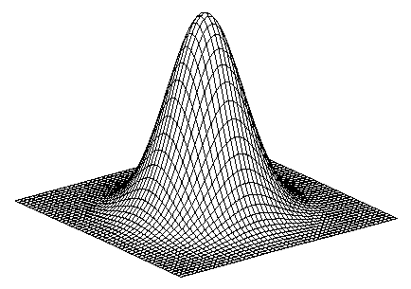
Application: Hybrid Images
A. Oliva, A. Torralba, P.G. Schyns, “Hybrid Images,” SIGGRAPH 2006
Gaussian Filter
Laplacian Filter
unit impulse
Gaussian
Laplacian of Gaussian

Slide 67

Aude Oliva & Antonio Torralba & Philippe G Schyns, SIGGRAPH 2006

Slide 68

Aude Oliva & Antonio Torralba & Philippe G Schyns, SIGGRAPH 2006

Slide 69
Summary
Image “noise”
Linear filters and convolution useful for
Enhancing images (smoothing, removing noise)
Box filter
Gaussian filter
Impact of scale / width of smoothing filter
Detecting features (next time)
Median filter: a non-linear filter, edge-preserving

